Slide 1
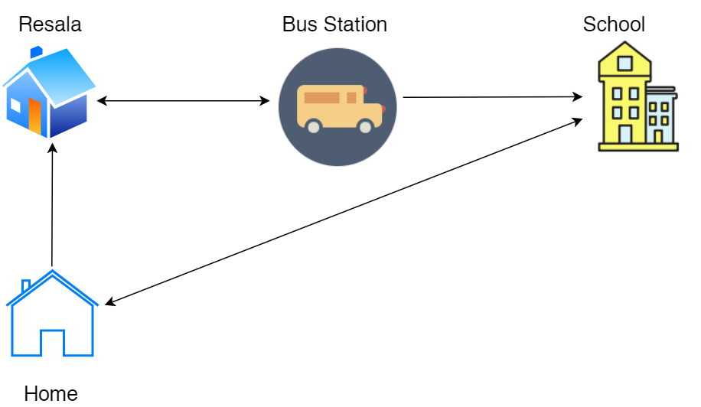
What are Data Structures?
Different ways of storing data on your computer

Slide 2


Strings
Chapter 6
Python for Everybody
www.py4e.com
Notes:
Note from Chuck. If you are using these materials, you can remove the UM logo and replace it with your own, but please retain the CC-BY logo on the first page as well as retain the acknowledgement page(s) at the end.

Slide 3
String Data Type
>>> str1 = "Hello"
>>> str2 = 'there'
>>> bob = str1 + str2
>>> print(bob)
Hellothere
>>> str3 = '123'
>>> str3 = str3 + 1
Traceback (most recent call last): File "<stdin>", line 1, in <module>
TypeError: cannot concatenate 'str' and 'int' objects
>>> x = int(str3) + 1
>>> print(x)
124
>>>
A string is a sequence of characters
A string literal uses quotes 'Hello' or "Hello"
For strings, + means “concatenate”
When a string contains numbers, it is still a string
We can convert numbers in a string into a number using int()

Slide 4
Reading and Converting
>>> name = input('Enter:')
Enter:Chuck
>>> print(name)
Chuck
>>> apple = input('Enter:')
Enter:100
>>> x = apple – 10
Traceback (most recent call last): File "<stdin>", line 1, in <module>
TypeError: unsupported operand type(s) for -: 'str' and 'int'
>>> x = int(apple) – 10
>>> print(x)
90
We prefer to read data in using strings and then parse and convert the data as we need
This gives us more control over error situations and/or bad user input
Input numbers must be converted from strings

Slide 5
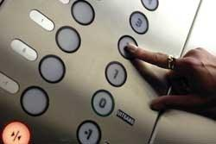
Looking Inside Strings
We can get at any single character in a string using an index specified in square brackets
The index value must be an integer and starts at zero
The index value can be an expression that is computed
b
a
n
a
n
a
0
1
2
3
4
5
>>> fruit = 'banana'
>>> letter = fruit[1]
>>> print(letter)
a
>>> x = 3
>>> w = fruit[x - 1]
>>> print(w)
n

Slide 6
A Character Too Far
You will get a python error if you attempt to index beyond the end of a string
So be careful when constructing index values and slices
>>> zot = 'abc'
>>> print(zot[5])
Traceback (most recent call last): File "<stdin>", line 1, in <module>
IndexError: string index out of range
>>>

Slide 7
Strings Have Length
The built-in function len gives us the length of a string
b
a
n
a
n
a
0
1
2
3
4
5
>>> fruit = 'banana'
>>> print(len(fruit))
6

Slide 8
len Function
>>> fruit = 'banana'
>>> x = len(fruit)
>>> print(x)
6
A function is some stored code that we use. A function takes some input and produces an output.
len()
function
'banana'
(a string)
6
(a number)

Slide 9
len Function
>>> fruit = 'banana'
>>> x = len(fruit)
>>> print(x)
6
A function is some stored code that we use. A function takes some input and produces an output.
def len(inp):
blah
blah
for x in y:
blah
blah
'banana'
(a string)
6
(a number)

Slide 10
Looping Through Strings
Using a while statement, an iteration variable, and the len function, we can construct a loop to look at each of the letters in a string individually
fruit = 'banana'
index = 0
while index < len(fruit):
letter = fruit[index]
print(index, letter)
index = index + 1
0 b
1 a
2 n
3 a
4 n
5 a

Slide 11
Looping Through Strings
A definite loop using a for statement is much more elegant
The iteration variable is completely taken care of by the for loop
b
a
n
a
n
a
fruit = 'banana'
for letter in fruit:
print(letter)

Slide 12
Looping Through Strings
A definite loop using a for statement is much more elegant
The iteration variable is completely taken care of by the for loop
fruit = 'banana'
for letter in fruit :
print(letter)
b
a
n
a
n
a
index = 0
while index < len(fruit) :
letter = fruit[index]
print(letter)
index = index + 1

Slide 13
Looping and Counting
This is a simple loop that loops through each letter in a string and counts the number of times the loop encounters the 'a' character
word = 'banana'
count = 0
for letter in word :
if letter == 'a' :
count = count + 1
print(count)

Slide 14
Looking Deeper into in
The iteration variable “iterates” through the sequence (ordered set)
The block (body) of code is executed once for each value in the sequence
The iteration variable moves through all of the values in the sequence
Iteration variable
Six-character string
for letter in 'banana' :
print(letter)

Slide 15
Yes
Done?
No
b
a
n
a
n
a
Advance letter
print(letter)
for letter in 'banana' :
print(letter)
The iteration variable “iterates” through the string and the block (body) of code is executed once for each value in the sequence

Slide 16
More String Operations

Slide 17
Slicing Strings
M
o
n
t
y
P
y
t
h
o
n
0
1
2
3
4
5
6
7
8
9
10
11
We can also look at any continuous section of a string using a colon operator
The second number is one beyond the end of the slice - “up to but not including”
If the second number is beyond the end of the string, it stops at the end
>>> s = 'Monty Python'
>>> print(s[0:4])
Mont
>>> print(s[6:7])
P
>>> print(s[6:20])
Python

Slide 18
Slicing Strings
M
o
n
t
y
P
y
t
h
o
n
0
1
2
3
4
5
6
7
8
9
10
11
If we leave off the first number or the last number of the slice, it is assumed to be the beginning or end of the string respectively
>>> s = 'Monty Python'
>>> print(s[:2])
Mo
>>> print(s[8:])
thon
>>> print(s[:])
Monty Python

Slide 19
String Concatenation
When the + operator is applied to strings, it means “concatenation”
>>> a = 'Hello'
>>> b = a + 'There'
>>> print(b)
HelloThere
>>> c = a + ' ' + 'There'
>>> print(c)
Hello There
>>>

Slide 20
Using in as a Logical Operator
>>> fruit = 'banana'
>>> 'n' in fruit
True
>>> 'm' in fruit
False
>>> 'nan' in fruit
True
>>> if 'a' in fruit :
... print('Found it!')
...
Found it!
>>>
The in keyword can also be used to check to see if one string is “in” another string
The in expression is a logical expression that returns True or False and can be used in an if statement

Slide 21
String Comparison
if word == 'banana':
print('All right, bananas.')
if word < 'banana':
print('Your word,' + word + ', comes before banana.')
elif word > 'banana':
print('Your word,' + word + ', comes after banana.')
else:
print('All right, bananas.')

Slide 22
String Library
Python has a number of string functions which are in the string library
These functions are already built into every string - we invoke them by appending the function to the string variable
These functions do not modify the original string, instead they return a new string that has been altered
>>> greet = 'Hello Bob'
>>> zap = greet.lower()
>>> print(zap)
hello bob
>>> print(greet)
Hello Bob
>>> print('Hi There'.lower())
hi there
>>>

Slide 23
>>> stuff = 'Hello world'
>>> type(stuff)
<class 'str'>
>>> dir(stuff)
['capitalize', 'casefold', 'center', 'count', 'encode', 'endswith', 'expandtabs', 'find', 'format', 'format_map', 'index', 'isalnum', 'isalpha', 'isdecimal', 'isdigit', 'isidentifier', 'islower', 'isnumeric', 'isprintable', 'isspace', 'istitle', 'isupper', 'join', 'ljust', 'lower', 'lstrip', 'maketrans', 'partition', 'replace', 'rfind', 'rindex', 'rjust', 'rpartition', 'rsplit', 'rstrip', 'split', 'splitlines', 'startswith', 'strip', 'swapcase', 'title', 'translate', 'upper', 'zfill']
https://docs.python.org/3/library/stdtypes.html#string-methods

Slide 24
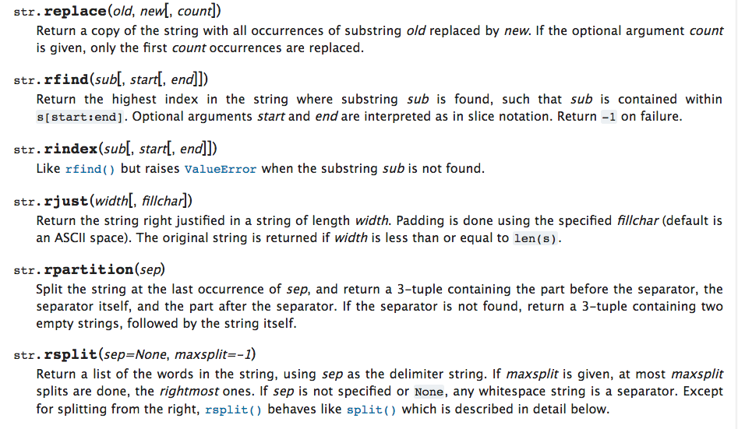

Slide 25
String Library
str.capitalize()
str.center(width[, fillchar])
str.endswith(suffix[, start[, end]])
str.find(sub[, start[, end]])
str.lstrip([chars])
str.replace(old, new[, count])
str.lower()
str.rstrip([chars])
str.strip([chars])
str.upper()

Slide 26
Searching a String
b
a
n
a
n
a
We use the find() function to search for a substring within another string
find() finds the first occurrence of the substring
If the substring is not found, find() returns -1
Remember that string position starts at zero
0
1
2
3
4
5
>>> fruit = 'banana'
>>> pos = fruit.find('na')
>>> print(pos)
2
>>> aa = fruit.find('z')
>>> print(aa)
-1

Slide 27
Making everything UPPER CASE
You can make a copy of a string in lower case or upper case
Often when we are searching for a string using find() we first convert the string to lower case so we can search a string regardless of case
>>> greet = 'Hello Bob'
>>> nnn = greet.upper()
>>> print(nnn)
HELLO BOB
>>> www = greet.lower()
>>> print(www)
hello bob
>>>

Slide 28
Search and Replace
The replace() function is like a “search and replace” operation in a word processor
It replaces all occurrences of the search string with the replacement string
>>> greet = 'Hello Bob'
>>> nstr = greet.replace('Bob','Jane')
>>> print(nstr)
Hello Jane
>>> nstr = greet.replace('o','X')
>>> print(nstr)
HellX BXb
>>>

Slide 29
Stripping Whitespace
Sometimes we want to take a string and remove whitespace at the beginning and/or end
lstrip() and rstrip() remove whitespace at the left or right
strip() removes both beginning and ending whitespace
>>> greet = ' Hello Bob '
>>> greet.lstrip()
'Hello Bob '
>>> greet.rstrip()
' Hello Bob'
>>> greet.strip()
'Hello Bob'
>>>

Slide 30
Prefixes
>>> line = 'Please have a nice day'
>>> line.startswith('Please')
True
>>> line.startswith('p')
False

Slide 31

Parsing and Extracting
21
31
From stephen.marquard@uct.ac.za Sat Jan 5 09:14:16 2008
>>> data = 'From stephen.marquard@uct.ac.za Sat Jan 5 09:14:16 2008'
>>> atpos = data.find('@')
>>> print(atpos)
21
>>> sppos = data.find(' ',atpos)
>>> print(sppos)
31
>>> host = data[atpos+1 : sppos]
>>> print(host)
uct.ac.za

Slide 32
Two Kinds of Strings
Python 2.7.10
>>> x = '이광춘'
>>> type(x)
<type 'str'>
>>> x = u'이광춘'
>>> type(x)
<type 'unicode'>
>>>
Python 3.5.1
>>> x = '이광춘'
>>> type(x)
<class 'str'>
>>> x = u'이광춘'
>>> type(x)
<class 'str'>
>>>
In Python 3, all strings are Unicode

Slide 33
Summary
String type
Read/Convert
Indexing strings []
Slicing strings [2:4]
Looping through strings with for and while
Concatenating strings with +
String operations
String library
String comparisons
Searching in strings
Replacing text
Stripping white space

Slide 34
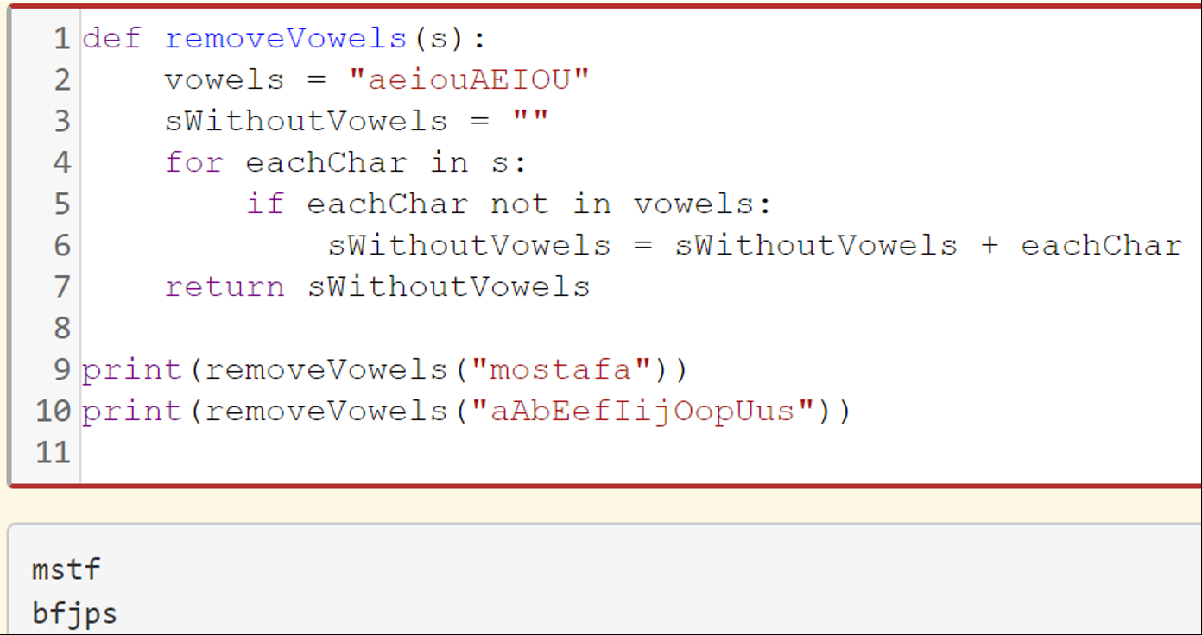
Exercise: Remove the Vowels from the word
Solution #1

Slide 35
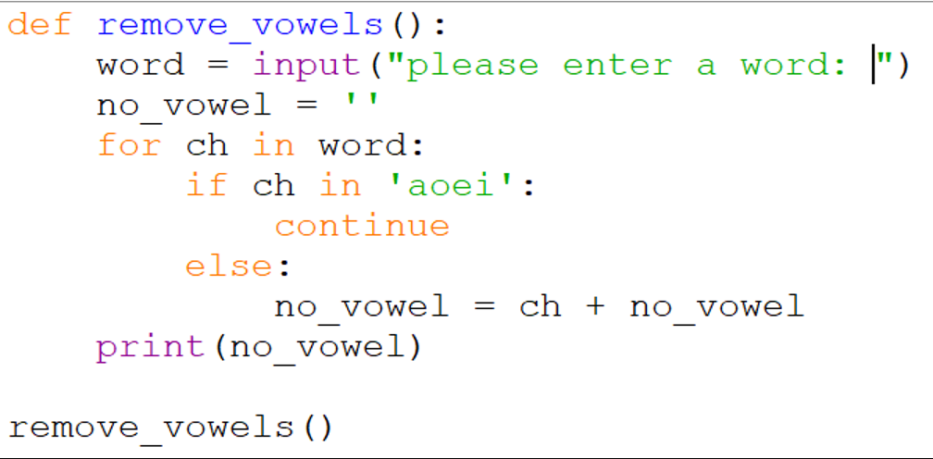
Exercise: Remove the Vowels from the word
Solution #2

Slide 36
Acknowledgements / Contributions
These slides are Copyright 2010- Charles R. Severance (www.dr-chuck.com) of the University of Michigan School of Information and open.umich.edu and made available under a Creative Commons Attribution 4.0 License. Please maintain this last slide in all copies of the document to comply with the attribution requirements of the license. If you make a change, feel free to add your name and organization to the list of contributors on this page as you republish the materials.
Initial Development: Charles Severance, University of Michigan School of Information
… Insert new Contributors and Translators here
...

